Slide 1
SPLIT IT
– an Android application for keeping track of debts

Slide 2
What is Split It?
Finance application
Targets young people
Active and interactive economic lives

Slide 3
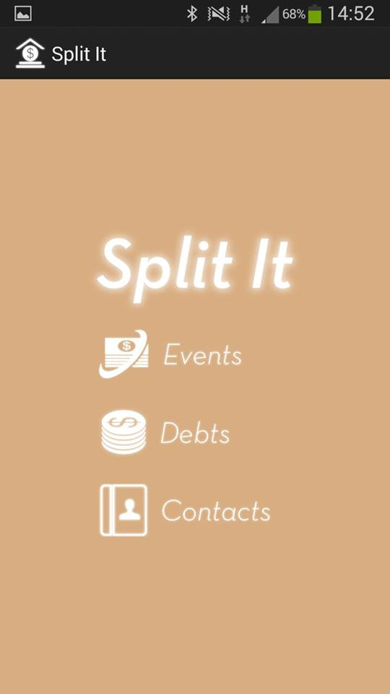
What does the app do?
Gives an overview of current
debt and owing statuses
Manages debts and owings
Create events

Slide 4
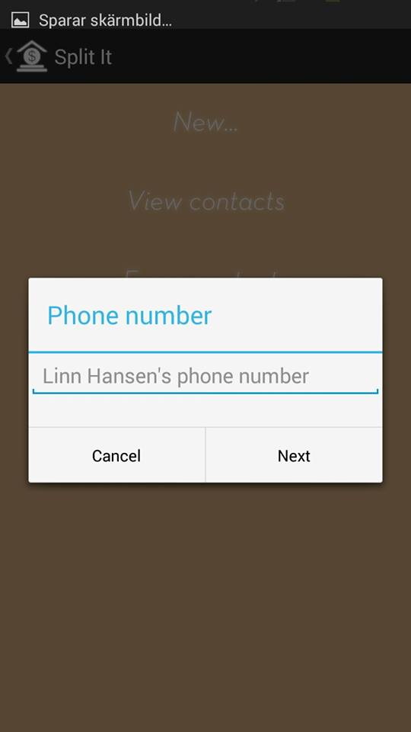
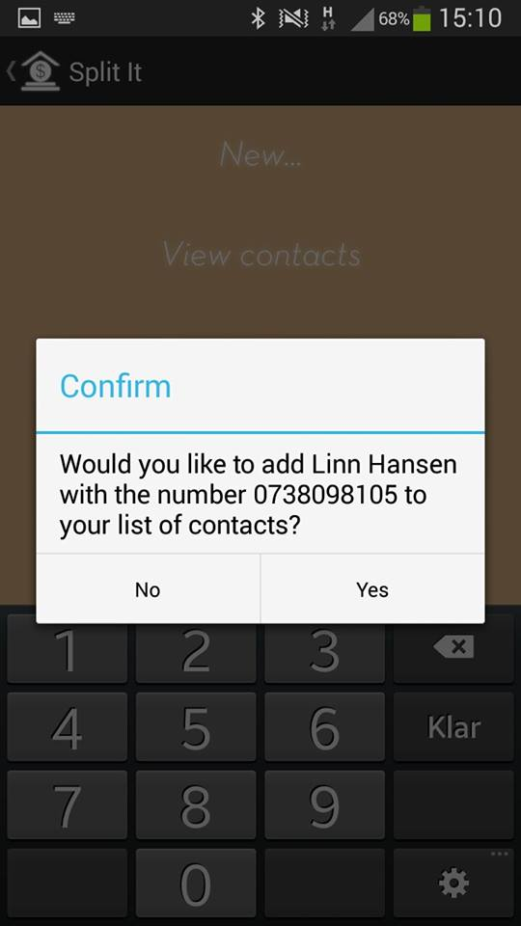
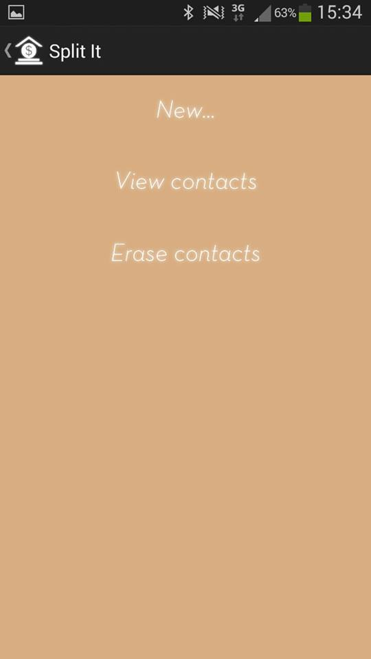
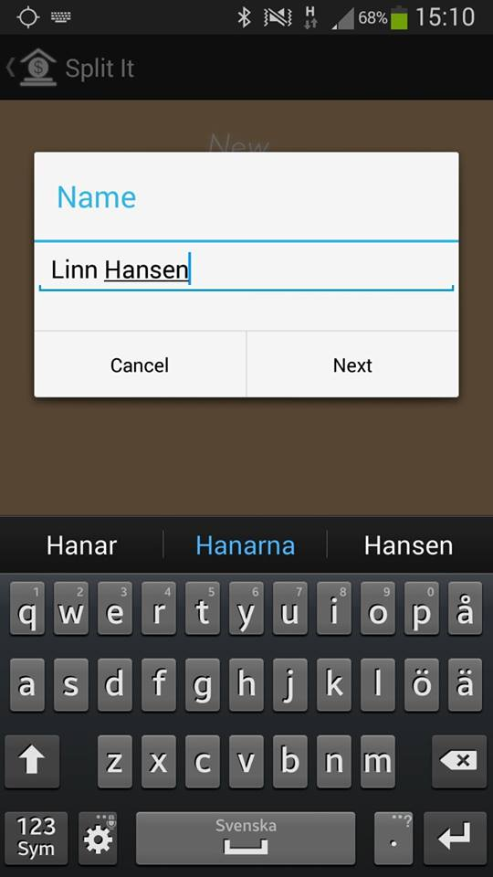
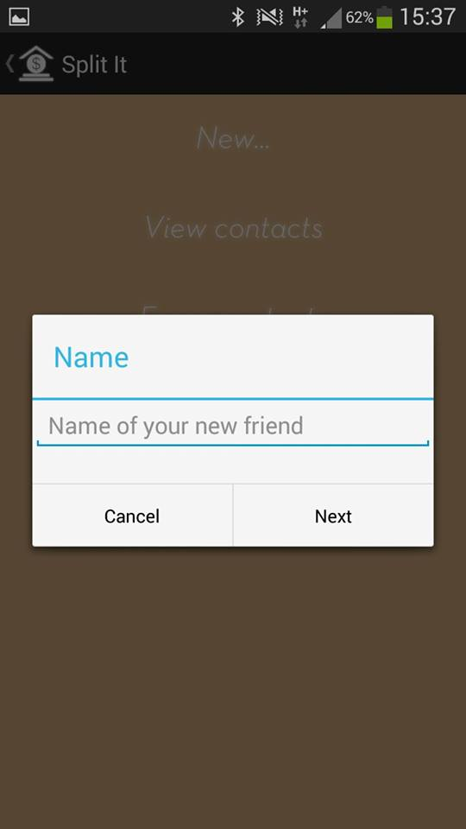
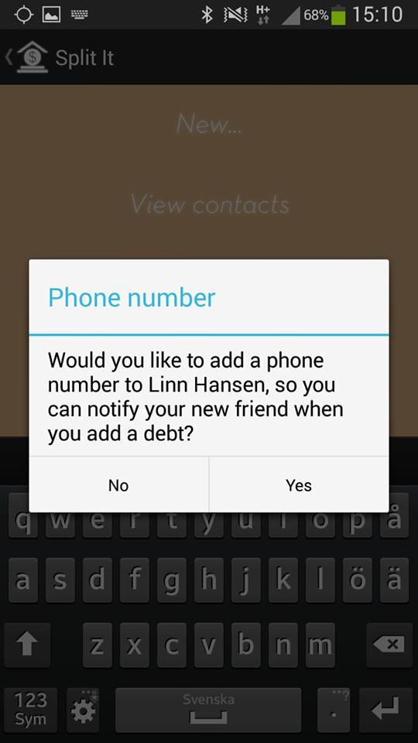
Current debt and owing statuses
Add a new contact
Name
Phone number
View contacts
Erase contacts

Slide 5
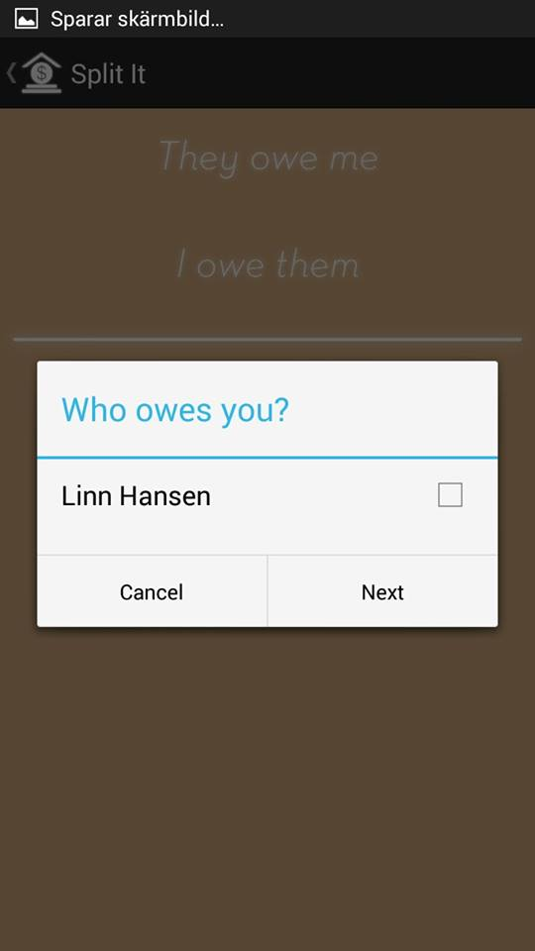
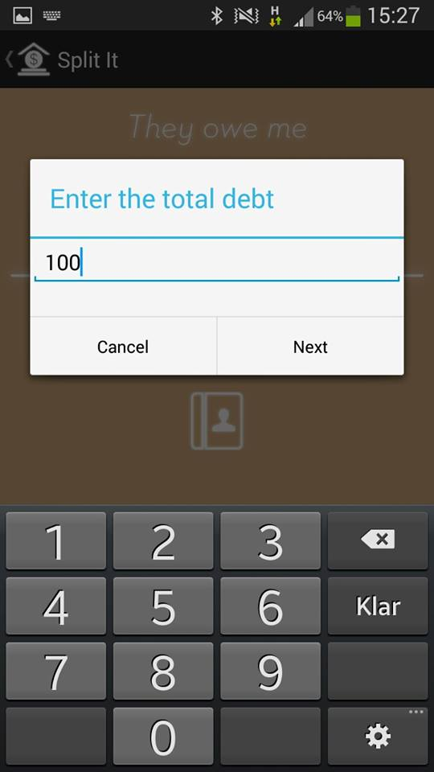
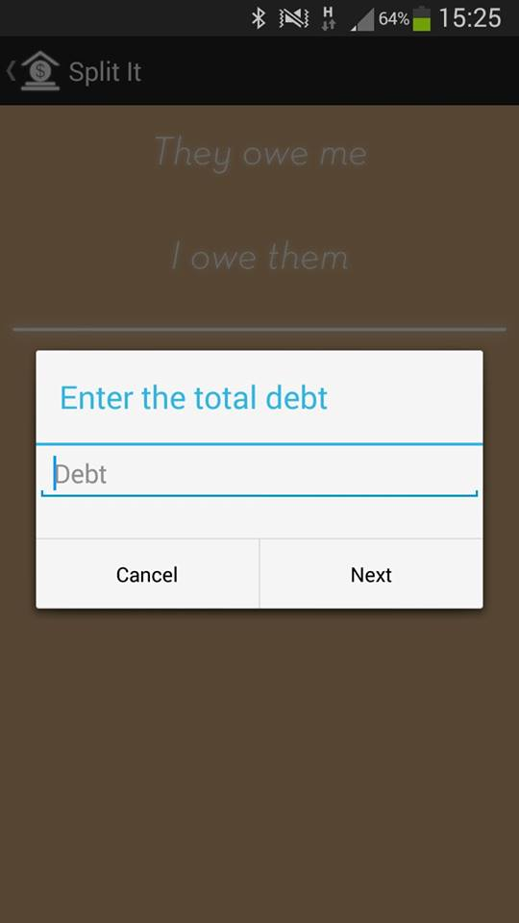
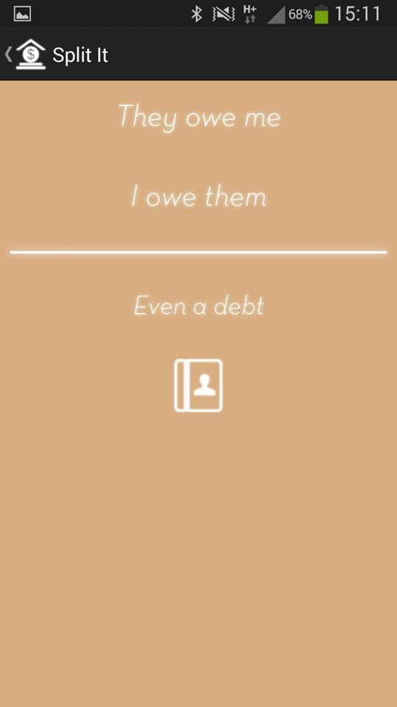
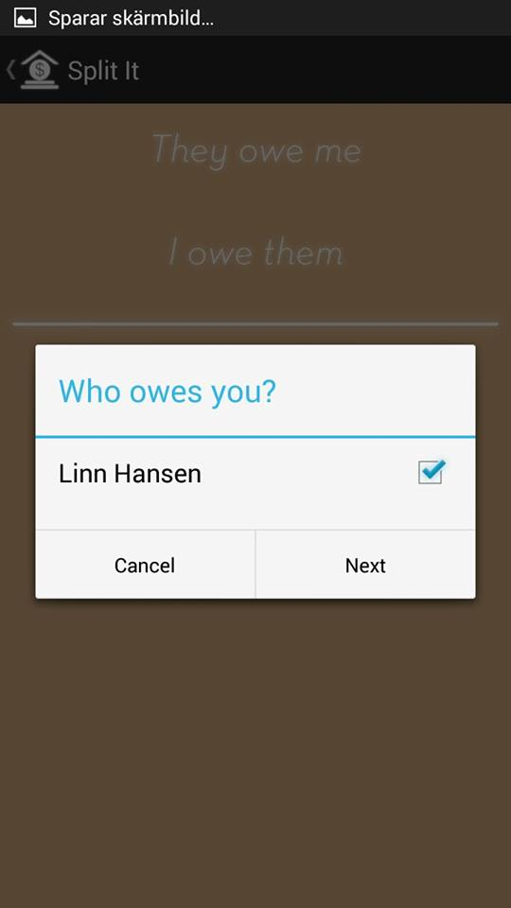
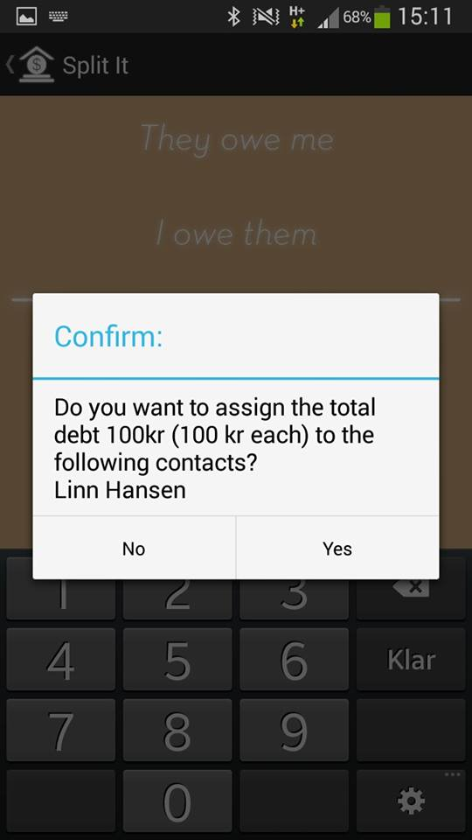
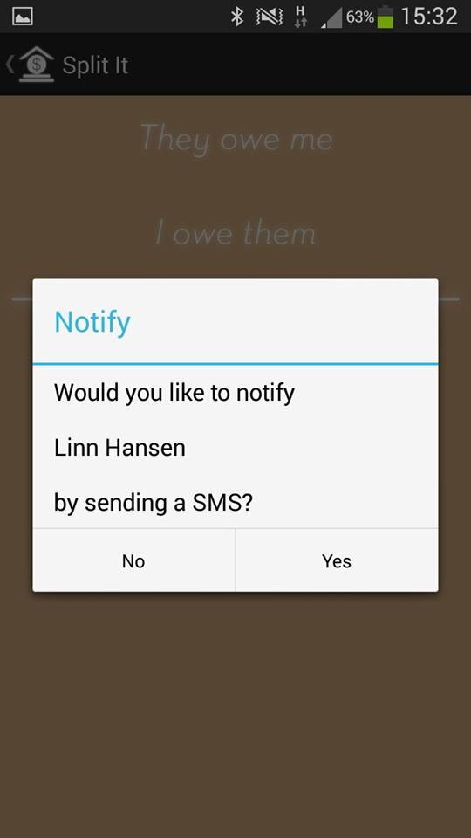
Manage debts and owings
Add debts and owings
Split debts between contacts
Delete debts or owings

Slide 6
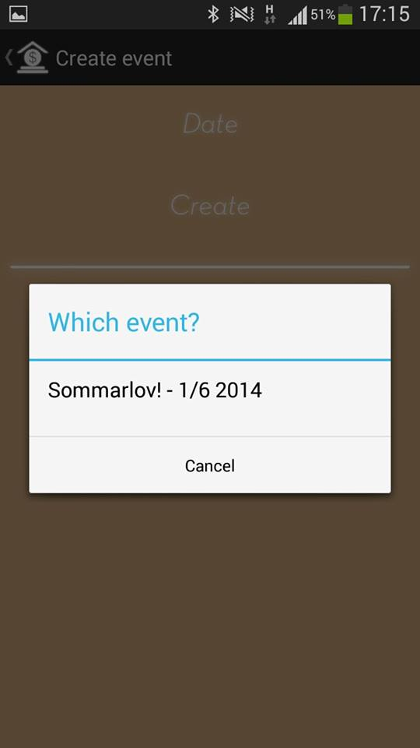
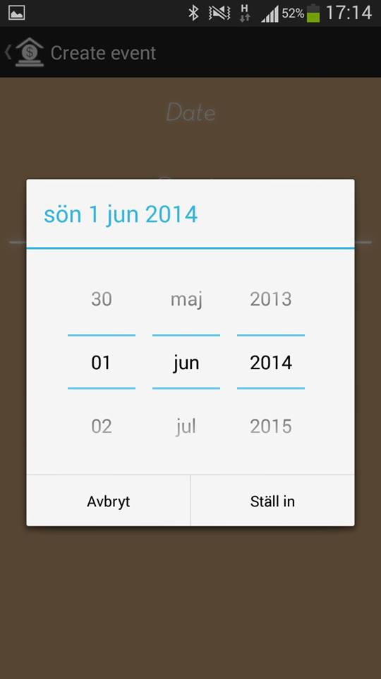
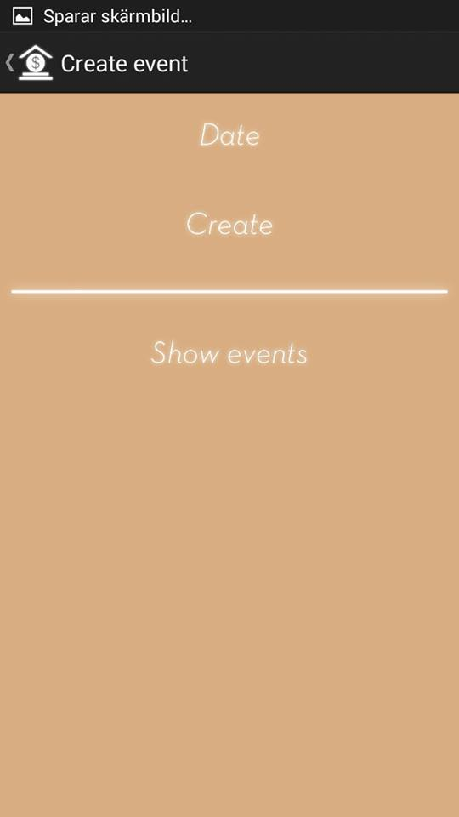
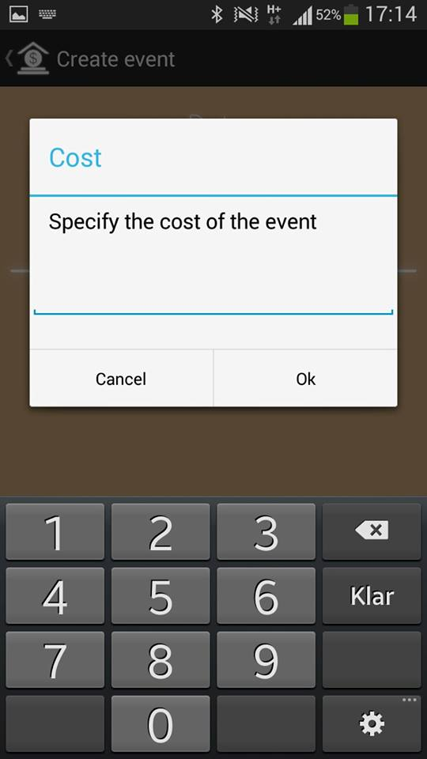
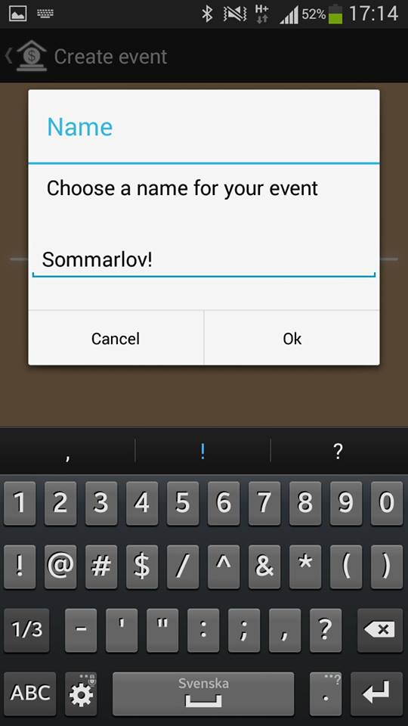
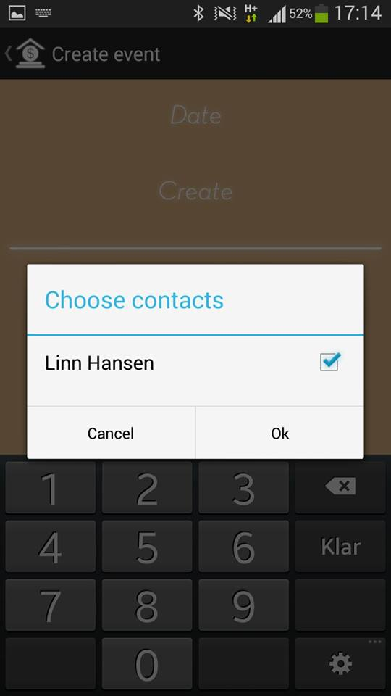
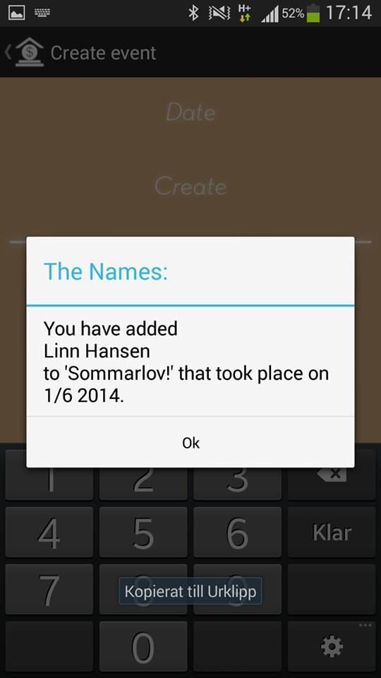
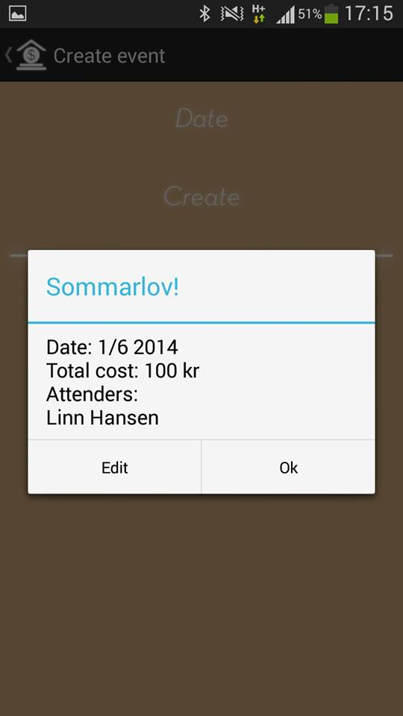
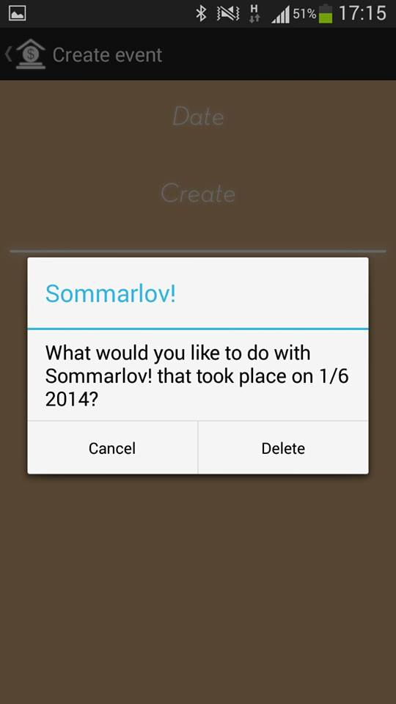
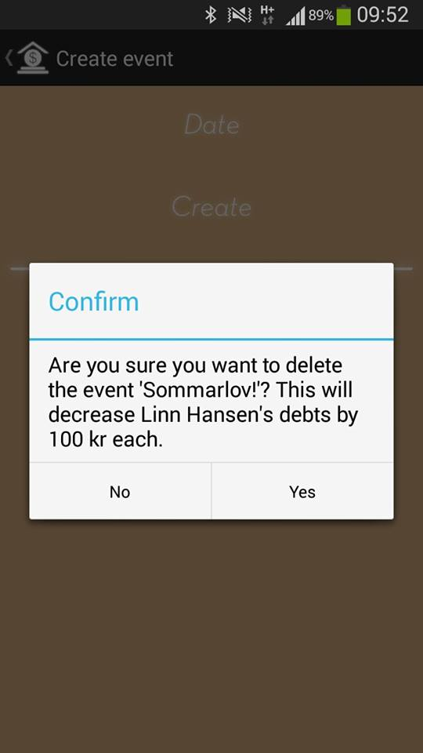
Create events
What?
When?
Who?
How much?
Split!

Slide 7
What makes it special?
Direct user interaction
Coordination of debts possible
Event functionality
Easy to use

Slide 8
Design decisions
Android Jelly Bean (SDK 16)
Needed for functionality
70 % of users
SMS for communication
Every phone is connected to a phone number
Might cost money

Slide 9
Work process
Scrum
Version Control System
Testing
Static testing
Dynamic testing
Black box testing
Unit testing
Acceptance tests

Slide 10
Reflections
Processes, practices and technologies
Importance of technical aid
Team work
Different competences
Roles
Planning

Slide 11

SPLIT IT USER

